Slide 1


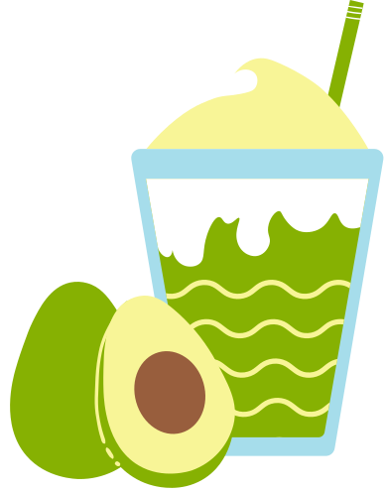




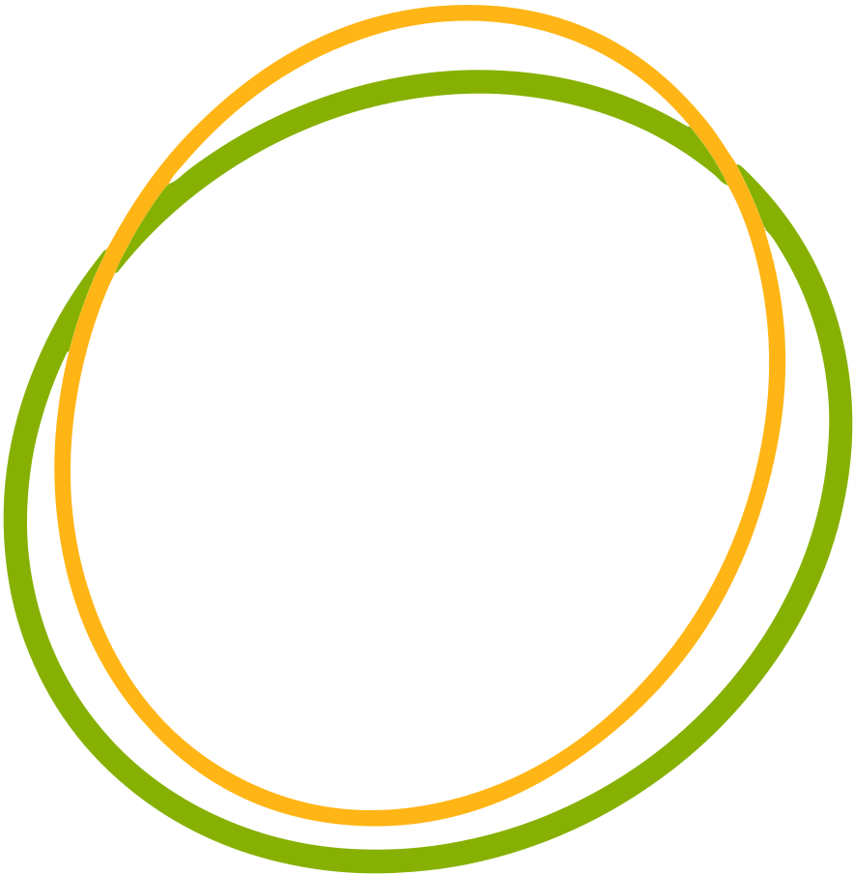
Diet
planner
Eat Smart. Live Better.
Presented by:
Tejaswani Singh-2201220100181
Yashi Tiwari-2201220100200
Mudit Srivastava-2201220100103
Nishant Tripathi-2201220100109

Slide 2


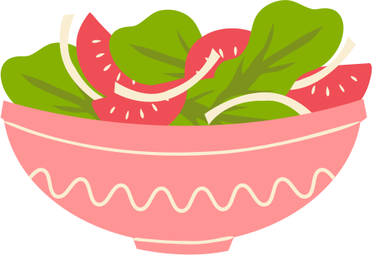




What's the Problem?
problem 1
problem 2
problem 3
Generic diet apps offer static meal plans
Manual meal tracking = user frustration
People need real, customized nutrition help

Slide 3

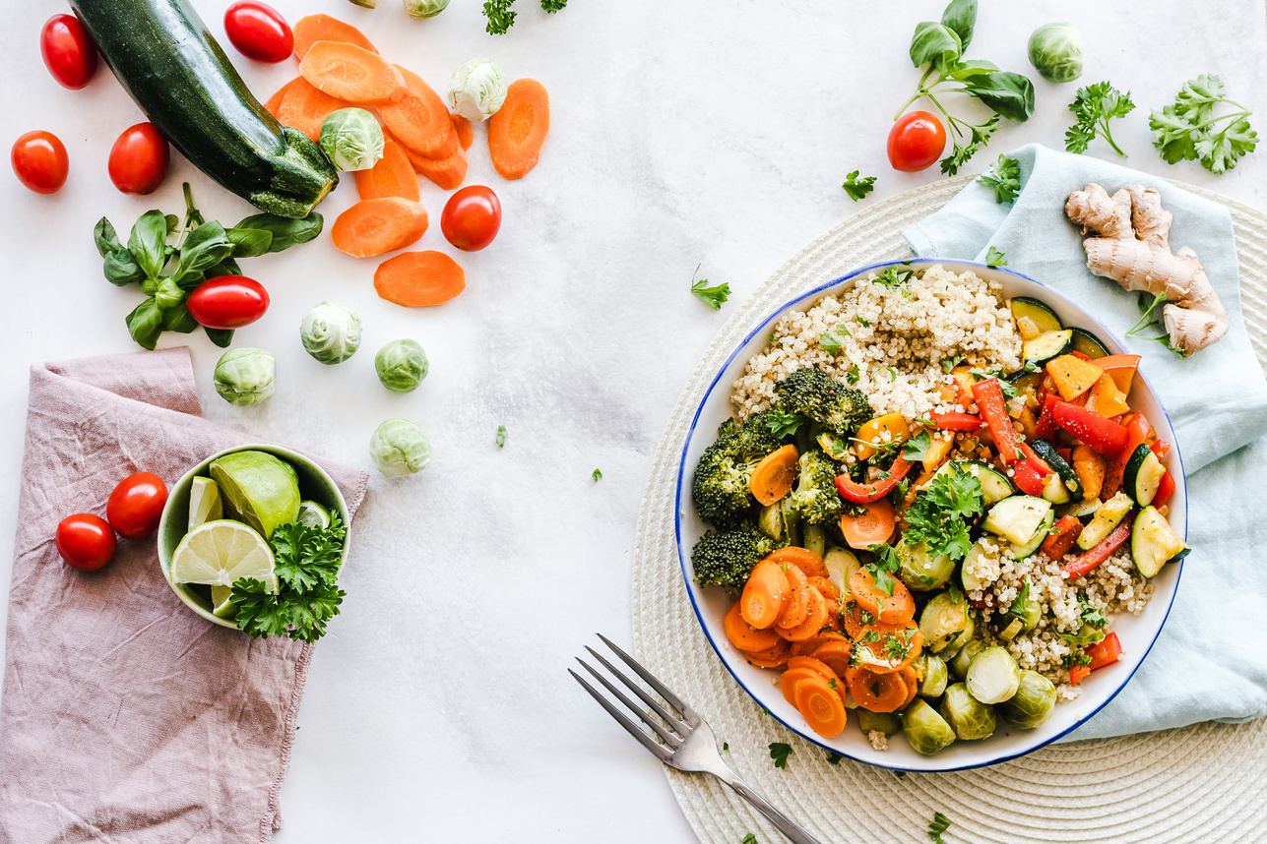
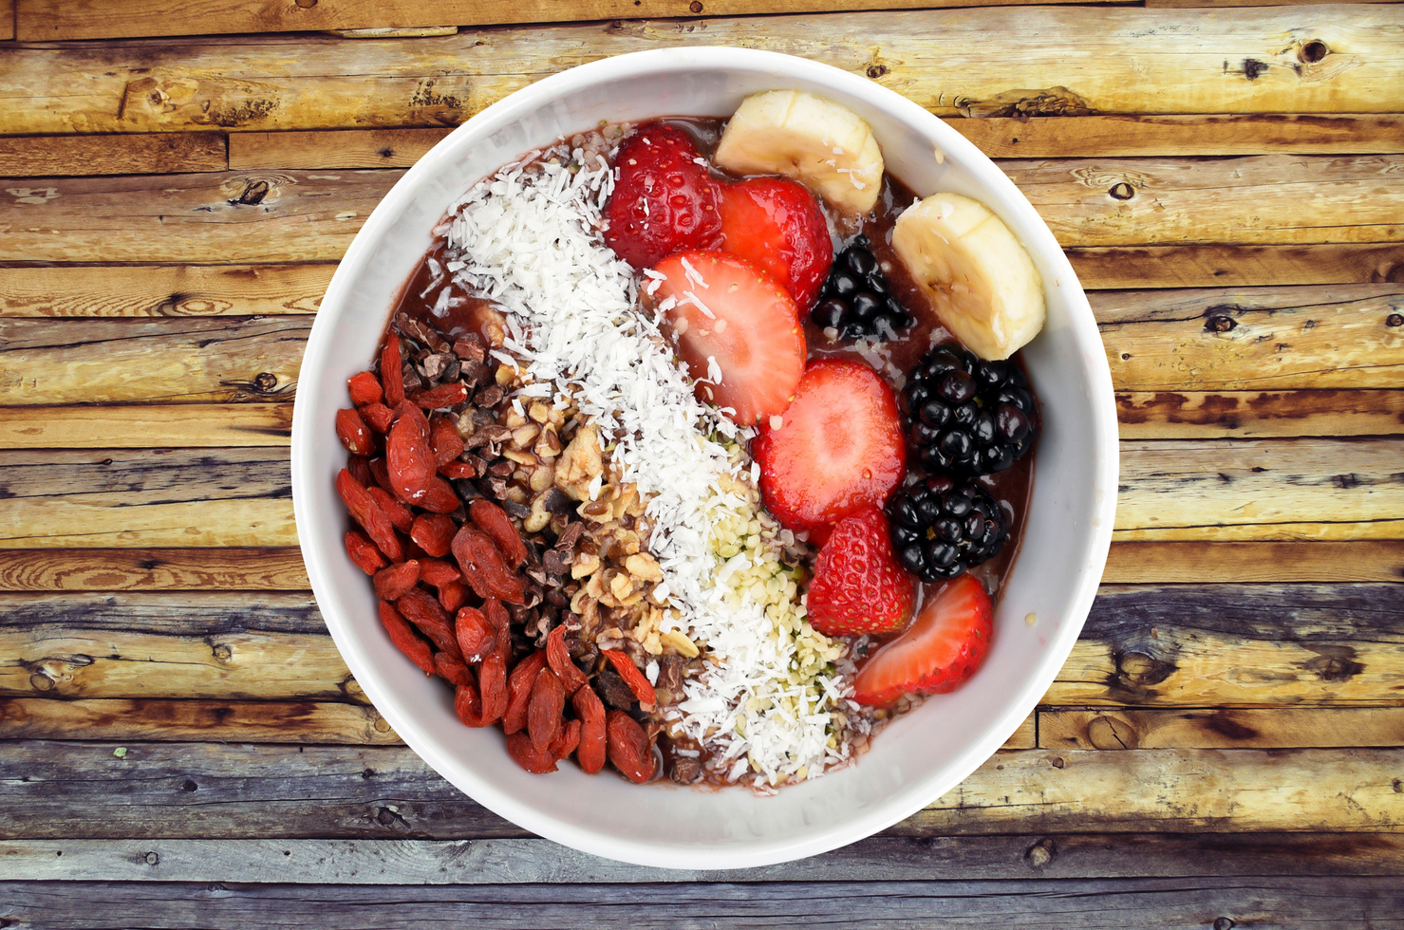
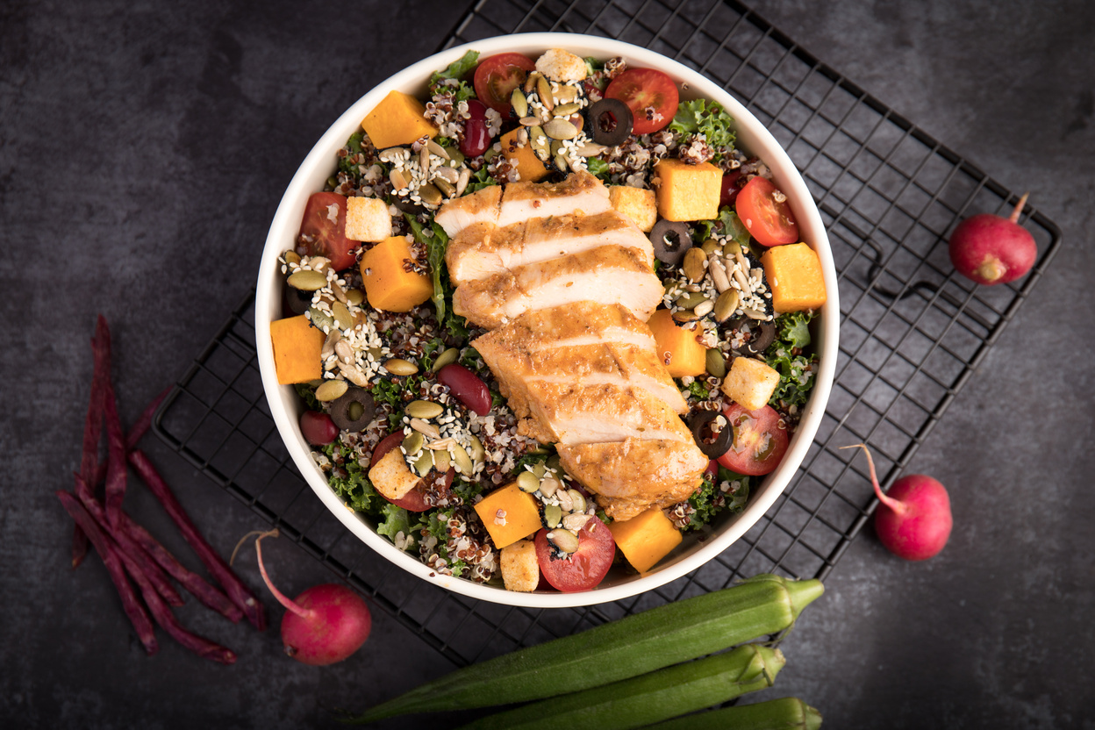
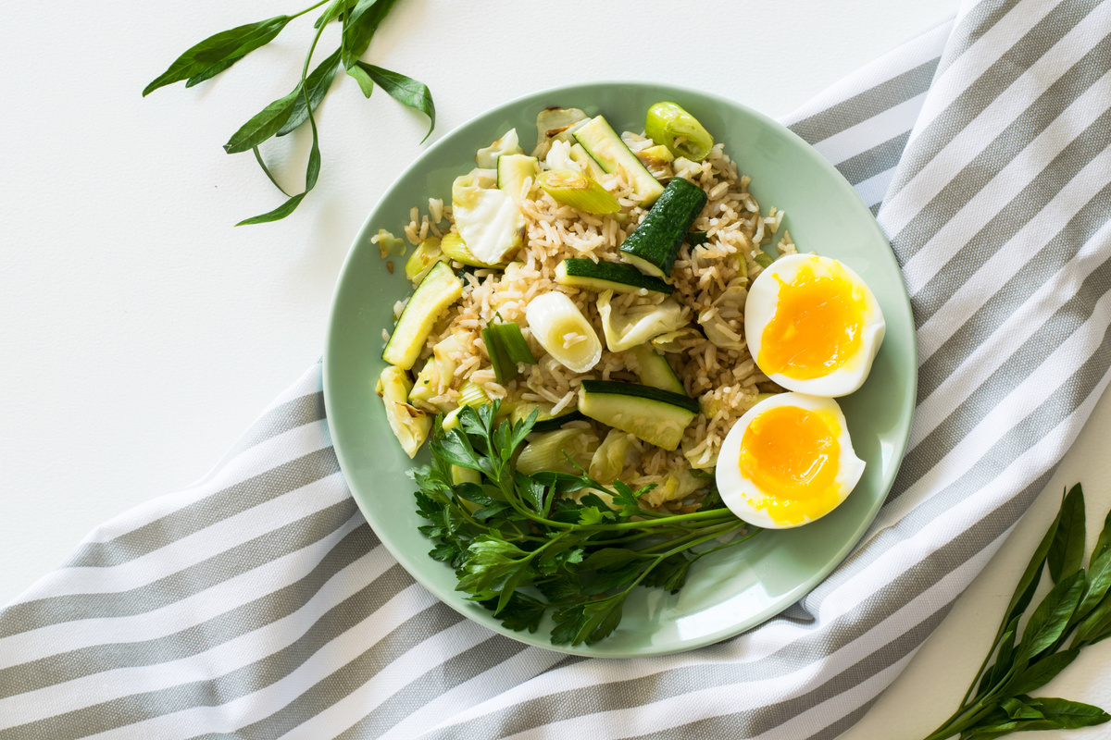
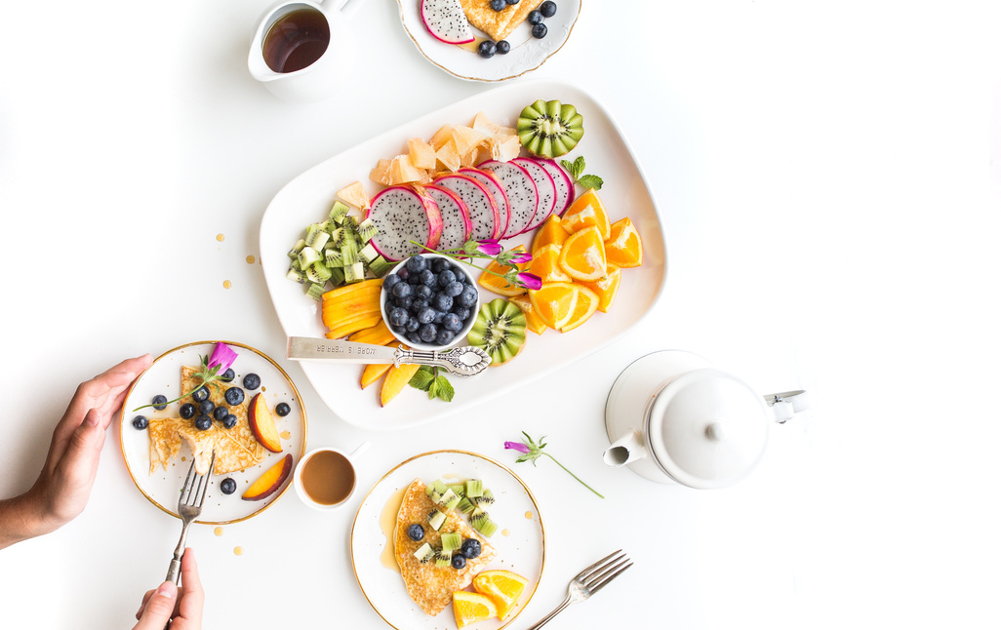
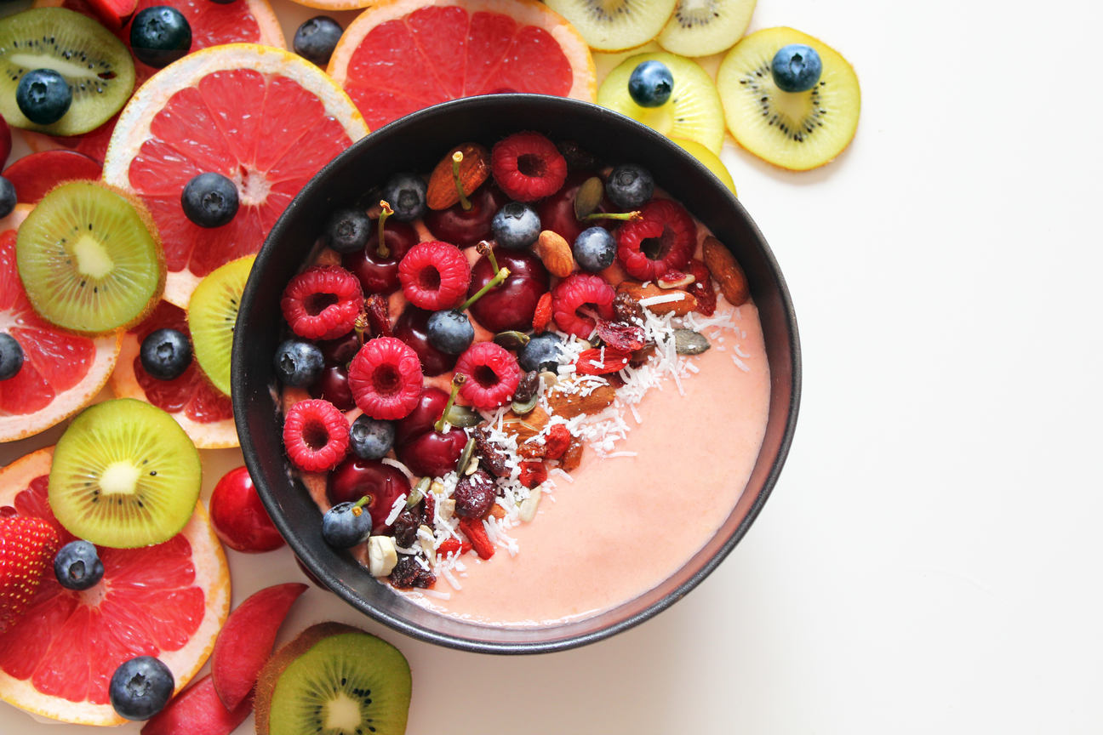
The Gap We Found
Why hasn’t this been solved yet?
❌ Lack of real-time AI personalization
❌ No adaptive meal suggestions
❌ User experience is boring and non-interactive
❌ Nutritional science is often oversimplified

Slide 4


Our Smart Solution
"A diet that adapts to YOU!"
✅ AI-powered web app for generating meal plans
✅ User profile: age, goals, preferences
✅ AI engine balances macros, calories, and taste!
✅ Beautiful dashboard with personalized suggestions

Slide 5




Behind the Magic (Tech Stack)
Frontend:
HTML5
CSS
javascript
Backend:
Python
Flask
database:
mongodb
AI Engine:
Custom logic (ai_meal_generator.py)
machine learning
Deployment:
render
version control:
Git
flow chart
User Inputs Profile
Ai engine
generate meal
plans
display in
dashboard

Slide 6

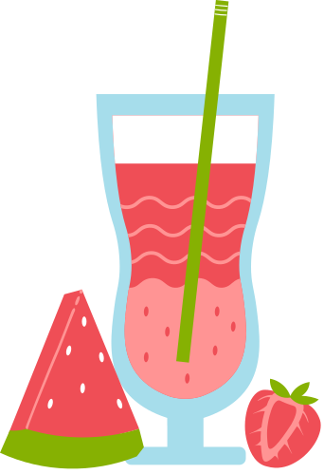
Feature Highlights
Week | M | T | W | Th | F | St | S
Week 1
Week 2
Week 3
Week 4
Week 5
🔐 Profile-based meal planning
🤖 AI-generated smart meals
📊 Interactive Dashboard
🧘 Healthy + Tasty options
✨ Clean, responsive design
📦 Easy to deploy & extend

Slide 7

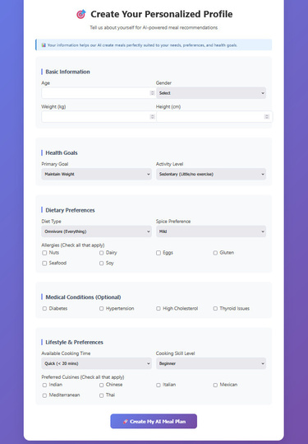
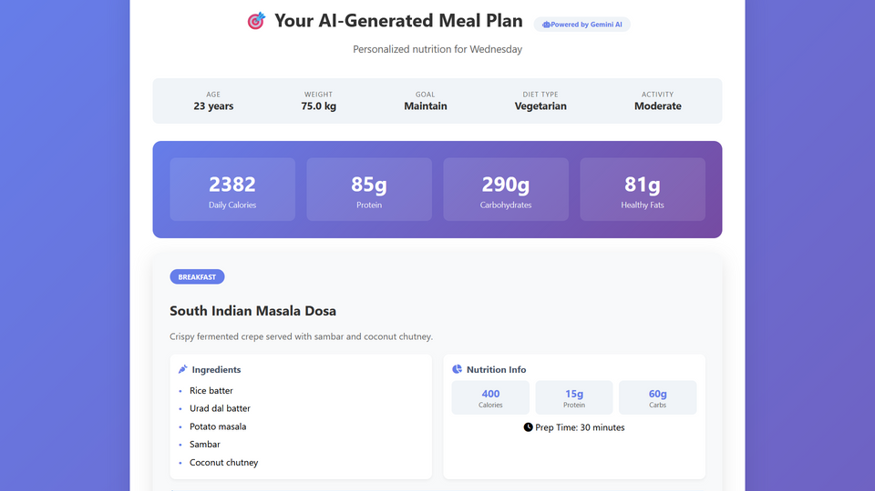
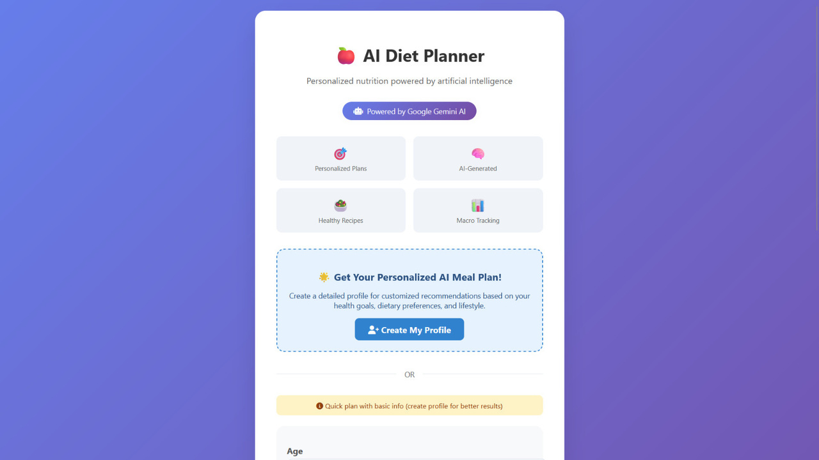
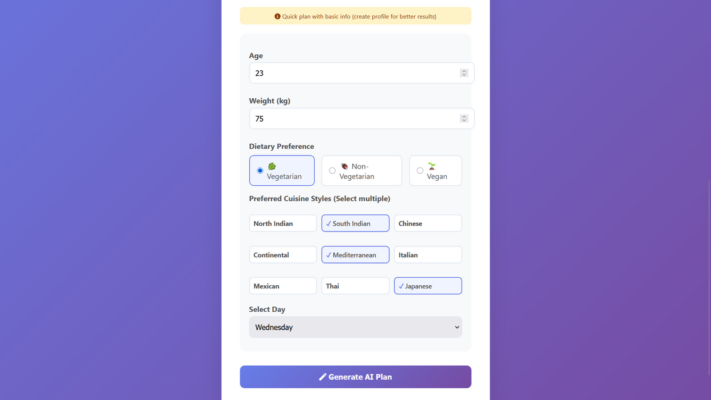
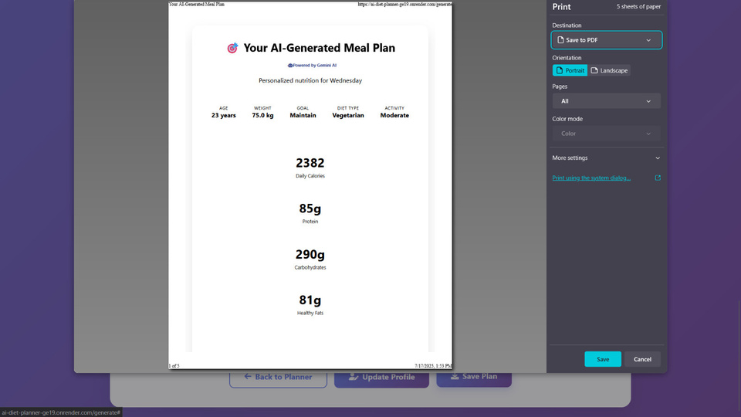

App Glimpses (Screenshots)
either one will guide you to
either one

Slide 8



What’s Next? (Future Upgrades)
🌱 Let’s make it even healthier, smarter, and cooler!
📱 Launch mobile app (React Native / Flutter)
🧠 Connect with smartwatches (Fitbit, Apple Health)
🧬 Auto-adapt plans based on health metrics
📷 Scan food via camera (image recognition)
🎙️ Add voice input & chatbot for lazy days 😅

Slide 9
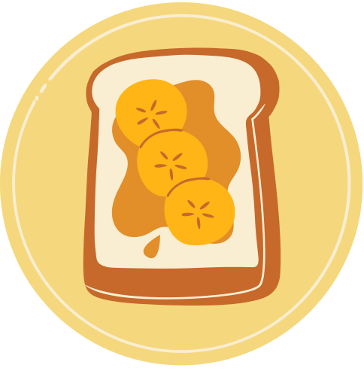





Any questions before we plan your plate?
Let’s talk food, fitness, and future!

Slide 10



give it a shot

